Slide 1

CSE- 207
Algorithms
Lecture: 17
Backtracking
Fahad Ahmed
Lecturer, Dept. of CSE
E-mail: fahadahmed@uap-bd.edu

Slide 2


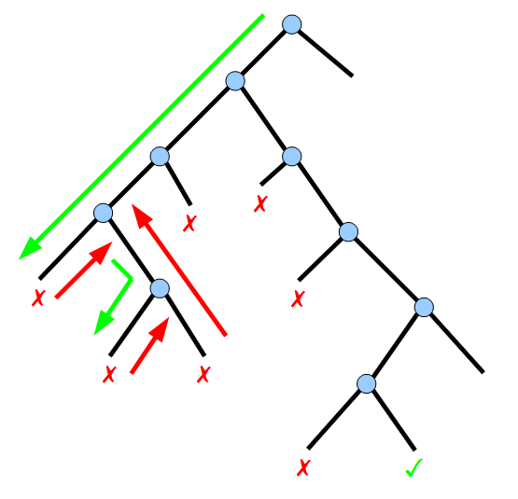
Backtracking

Slide 3
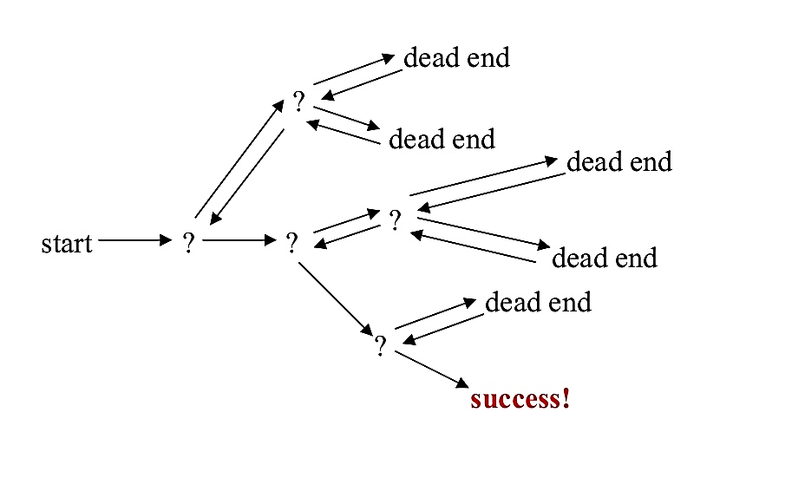
Backtracking
What is Backtracking?
Backtracking is an algorithmic-technique for solving problems recursively by trying to build a solution incrementally, one piece at a time, removing those solutions that fail to satisfy the constraints of the problem at any point of time (by time, here, is referred to the time elapsed till reaching any level of the search tree).

Slide 4
Backtracking
What is Backtracking?
According to the wiki definition,
Backtracking can be defined as a general algorithmic technique that considers searching every possible combination in order to solve a computational problem.

Slide 5
Backtracking
How to determine if a problem can be solved using Backtracking?
Every constraint satisfaction problem which has well-defined constraints can be solved by Backtracking.
There are three types of problems which can be solved using backtracking :
Decision Problem : Search for a feasible solution
Optimisation Problem : Search for the best solution
Enumeration Problem : Find all feasible solutions

Slide 6
Backtracking
History of Backtracking
‘Backtrack’ the Word was first introduced by Dr. D.H. Lehmer in 1950s.
R.J Walker Was the First man who gave algorithmic description in 1960.
Later, developed by S. Golamb and L. Baumert.
The pioneer string-processing language SNOBOL (1962) may have been the first to provide a built-in general backtracking facility.
General Approach for Backtracking
Step 1 − if current_position is goal, return success
Step 2 − else,
Step 3 − if current_position is an end point, return failed.
Step 4 − else, if current_position is not end point, explore and repeat above steps.

Slide 7
Which problem are solved by using backtracking procedure?
N Queen Problem
The Knight’s tour problem
Rat in a Maze
m Coloring Problem or Graph coloring problem
Subset Sum
Binary strings : generating all binary strings
Generation k-array strings
Knapsack problem
Hamiltonian cycles
Remove Invalid Parentheses
Solving Cryptarithmetic Puzzles

Slide 8
Backtracking
Backtracking Advantages
Comparison with the Dynamic Programming, Backtracking Approach is more effective in some cases.
Backtracking Algorithm is the best option for solving tactical problem.
Also Backtracking is effective for constraint satisfaction problem.
In greedy Algorithm, getting the Global Optimal Solution is a long procedure and depends on user statements but in Backtracking It Can Easily getable.
Backtracking technique is simple to implement and easy to code.
Different states are stored into stack so that the data or Info can be usable anytime.
The accuracy is granted.

Slide 9
Backtracking
Backtracking Disadvantages
Backtracking Approach is not efficient for solving big strategic problem.
The overall runtime of Backtracking Algorithm is normally slow.
To solve large problem sometime it needs to take the help of other techniques like Branch and bound.
Need large amount of memory space for storing different state function in the stack for big problem.
Thrashing is one of the main problem of Backtracking.

Slide 10
Backtracking vs Recursion
Recursion is a technique that calls the same function again and again until you reach the base case.
Backtracking is an algorithm that finds all the possible solutions and selects the desired solution from the given set of solutions.
Link: https://www.hackerearth.com/practice/basic-programming/recursion/recursion-and-backtracking/tutorial/

Slide 11
N- Queen Problem

Slide 12
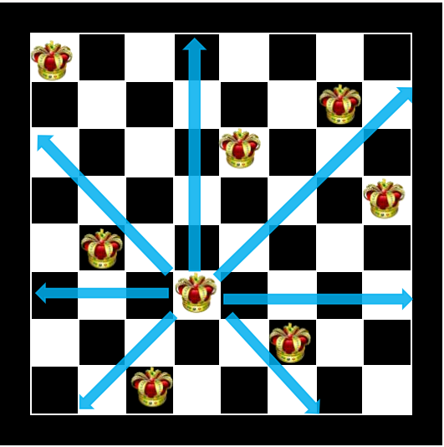
N- Queen Problem
The problem is to place n queens on an N-by-N chessboard so that no two queens attack each other .
No two Queens can be placed in same row.
No two Queens Can be places in same Column
No two queens Can be placed in same Diagonal.
Observation:
Case1 : N=1 Case 2 : N=2 Case 3 : N=3 [N=1,2,3 are not possible ]
Case 4 : N=4 Case 5 : N=5
So, on…….
The solution possibilities are discovered only up to 23 queen by backtracking approach.

Slide 13

N- Queen Problem
Backtracking approach : N- Queen Problem
The idea is to place queens one by one in different columns, starting from the leftmost column.
When we place a queen in a column, we check for clashes with already placed queens.
In the current column, if we find a row for which there is no clash, we mark this row and column as part of the solution.
If we do not find such a row due to clashes then we backtrack and return false.

Slide 14
N- Queen Problem
Algorithm
1) Start in the leftmost column
2) If all queens are placed
return true
3) Try all rows in the current column.
Do following for every tried row.
a) If the queen can be placed safely in this row
then mark this [row, column] as part of the
solution and recursively check if placing
queen here leads to a solution.
b) If placing the queen in [row, column] leads to
a solution then return true.
c) If placing queen doesn't lead to a solution then
unmark this [row, column] (Backtrack) and go to
step (a) to try other rows.
4) If all rows have been tried and nothing worked,
return false to trigger backtracking.

Slide 15


N- Queen Problem
Consider, 4 Queens

Slide 16
4- Queen Problem

Slide 17
4- Queen Problem

Slide 18
4- Queen Problem

Slide 19
4- Queen Problem

Slide 20
4- Queen Problem

Slide 21
4- Queen Problem

Slide 22
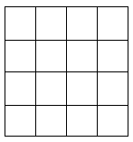
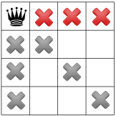
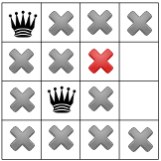
N- Queen Problem
4- Queen Problem Solution: find a false movements

Slide 23
4- Queen Problem

Slide 24
4- Queen Problem

Slide 25
4- Queen Problem

Slide 26
4- Queen Problem

Slide 27
4- Queen Problem

Slide 28
4- Queen Problem

Slide 29
4- Queen Problem

Slide 30
4- Queen Problem

Slide 31
4- Queen Problem

Slide 32
4- Queen Problem

Slide 33
4- Queen Problem

Slide 34
4- Queen Problem

Slide 35
4- Queen Problem

Slide 36
4- Queen Problem

Slide 37
4- Queen Problem

Slide 38
4- Queen Problem

Slide 39
4- Queen Problem

Slide 40




4- Queen Problem
TIO

Slide 41
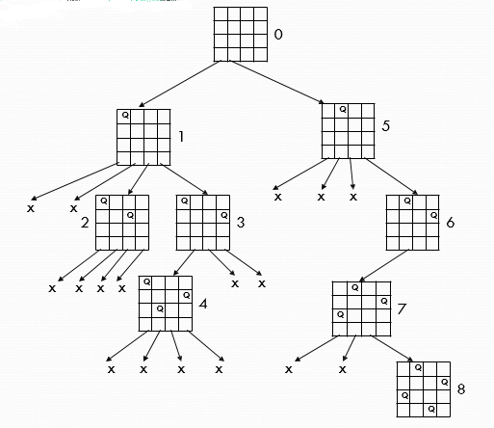
4- Queen Problem
4- Queen Problem Solution at a glance

Slide 42
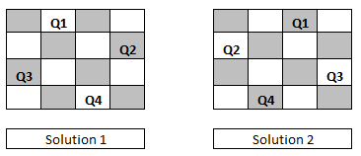
4- Queen Problem
4- Queen Problem Final Solution
In 4 queen problem there have only two solutions, one solution is mirror with another.

Slide 43
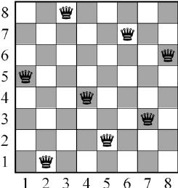
8- Queen Problem
First Introduced in 1848 which was known as N- queens Puzzle. Surprisingly, The First Solution was created in 1950 by Franz Nauck. Nauck made an 8X8 Chessboard to find the first Feasible Solution.
The eight queens puzzle has 92 distinct solutions.
If solutions that differ only by symmetry operations(rotations and reflections) of the board are counted as one the puzzle has 12 unique (or fundamental) solutions
Note that the six queens puzzle has fewer solutions than the five queens puzzle.
There is currently no known formula for the exact number of solutions.

Slide 44
8- Queen Problem
A fundamental solution usually has eight variants (including its original form) obtained by rotating 90, 180, or 270° and then reflecting each of the four rotational variants in a mirror in a fixed position.
However, one of the 12 fundamental solutions (solution 12 below) is identical to its own 180° rotation, so has only four variants (itself and its reflection, its 90° rotation and the reflection of that). Such solutions have only two variants (itself and its reflection).
Thus, the total number of distinct solutions is 11×8 + 1×4 = 92.

Slide 45
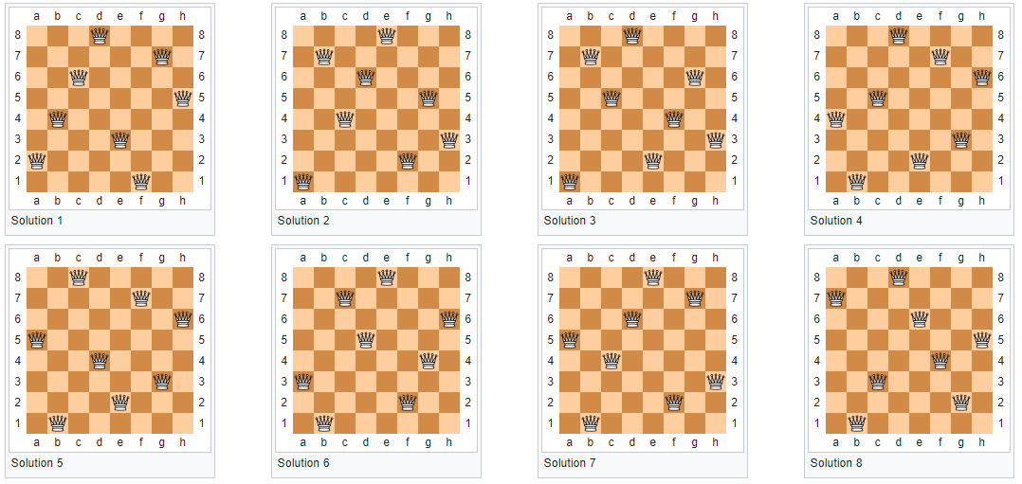
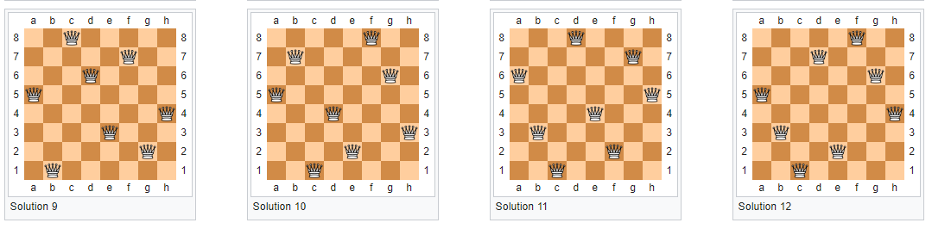
8- Queen Problem

Slide 46
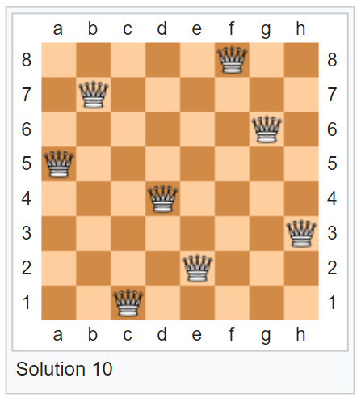
8- Queen Problem
“No-three-in-line problem”

Slide 47
N- Queen Problem Solution Comparison
Order
(“N”)
Total Solutions
Unique Solutions
Exec time
----------------------------------------------------------------------------------------------
1
2
3
4
5
6
7
8
9
10
11
12
13
14
1
0
0
2
10
4
40
92
352
724
2,680
14,200
73,712
365,596
1
0
0
1
2
1
6
12
46
92
341
1,787
9,233
45,752
< 0
< 0
< 0
< 0
< 0
< 0
< 0
< 0
< 0
< 0
< 0
< 0
< 0
seconds
seconds
seconds
seconds
seconds
seconds
seconds
seconds
seconds
seconds
seconds
seconds
seconds
0.2s

Slide 48
N- Queen Problem Solution Comparison
15
16
17
18
19
20
21
22
23
24
25
26
2,279,184
14,772,512
95,815,104
666,090,624
4,968,057,848
39,029,188,884
314,666,222,712
2,691,008,701,644
24,233,937,684,440
227,514,171,973,736
2,207,893,435,808,352
22,317,699,616,364,044
285,053
1,846,955
11,977,939
83,263,591
621,012,754
4,878,666,808
39,333,324,973
336,376,244,042
3,029,242,658,210
28,439,272,956,934
275,986,683,743,434
2,789,712,466,510,289
1.9 s
11.2 s
77.2 s
9.6 m
75.0 m
10.2 h
87.2 h
31.9
296 d
?
?
?
(s = seconds
m = minutes
h = hours
d = days)

Slide 49
N- Queen Problem
bool solveNQUtil(int board[N][N], int col)
{
if (col >= N)
return true;
for (int i = 0; i < N; i++)
{
if (isSafe(board, i, col))
{
board[i][col] = 1;
if (solveNQUtil(board, col + 1))
return true;
board[i][col] = 0; // BACKTRACK
}
}
return false;
}
base case: If all queens are placed then return true
Check if the queen can be placed on board[i][col]
Place this queen in board[i][col]
recur to place rest of the queens
If placing queen in board[i][col] doesn't lead to a solution, then remove queen from board[i][col]
If the queen cannot be placed in any row in
this column col then return false

Slide 50

Thanks to All

